Slide 1
Individual Project Presentation: Shopping Website & Authentication Features
Pan Yangshen DC325022
Notes:
Good morning/afternoon, everyone. My name is XXX. Today, I'm excited to share two projects I've been working on by following some excellent tutorials. First, we'll look at a shopping website I built, and then we'll dive into some key authentication features I implemented. Throughout this presentation, I'll be highlighting the functionalities of these projects and the technologies that made them possible

Slide 2
Part A: Shopping Website
Objective: Gained hands-on experience building a complete e-commerce platform.
Method: Followed a tutorial to understand core components, interactions, and development process.
Notes:
Next, I'd like to walk you through a shopping website I developed by following a tutorial. The primary goal of this project was to gain hands-on experience in building a functional e-commerce platform from the ground up, understanding the core components and interactions involved in such a system.

Slide 3
Part A: Shopping Website
Frontend (User Interface & Interaction):
HTML: Base structure and content.
CSS: Styling and visual presentation.
JavaScript: Dynamic behavior and user interactions.
Backend (Server-side Logic & Data):
XAMPP: Development Environment
Apache: Web Server
PHP: Server-side scripting (form processing, database interaction, business logic).
MySQL: Relational Database (for product, user, and order data).
Notes:
Let's talk about the technologies that powered this website. For the **frontend**, the part you see and interact with in your browser, I utilized a combination of **HTML** for the structure, **CSS** for styling and presentation, and **JavaScript** to handle dynamic content and user interactions. To create a responsive and modern user interface, I also incorporated a popular framework like **React**. This allowed for the creation of reusable UI components and efficient state management, making the user experience smooth and intuitive.
Moving to the **backend**, which handles the server-side logic, data processing, and database interactions, I used **XAMPP**. This development environment provided an **Apache web server**, and I utilized **PHP** for all the server-side scripting. PHP was responsible for processing form submissions, interacting with the database, and managing business logic. For the database, where all the product information, user data, and order details are stored, I opted for **MySQL**, a robust relational database. Its structured nature was well-suited for managing the defined relationships between products, users, and orders in an e-commerce application.

Slide 4
Part A: Shopping Website
Admin capability to add new products.
Inputs: Product Name, Price, Image.
Process (PHP & MySQL):
Admin inputs details via HTML form.
PHP backend script processes submitted data.
Image uploaded to server (managed by PHP).
Product details inserted into MySQL database.
Notes:
Now, let's dive into the key features of the shopping website. The first one is **Product Upload**. As an administrator, I can easily add new products to the store. This involves navigating to a dedicated admin interface where I can input the product's name, set its price, and upload an accompanying image. Once submitted, this information is processed by the **PHP backend scripts**, the image is stored on the server, and the product details are saved into our **MySQL database**, ready to be displayed to customers.

Slide 5
Part A: Shopping Website
"View Products" Page: Main storefront for users.
Product Display: Name, Price, Image (retrieved from MySQL by PHP scripts).
User Actions:
"Add to Cart": Saves item to cart (managed by PHP sessions or MySQL table).
"Buy": Directs to checkout for the selected item.
Notes:
Once products are uploaded, they appear on the **'View Products' page**. This is the main storefront where users can browse through the available items. Each product listing displays its name, price, and image, retrieved from the MySQL database by PHP scripts. For each item, users have two primary actions: **'Add to Cart'** or **'Buy'**. Clicking 'Add to Cart' will save the item to their personal shopping cart, often managed using PHP sessions or database entries, allowing them to continue browsing or proceed to checkout later. The 'Buy' option would typically take them directly to the checkout process for that single item, offering a quicker path for decisive shoppers.

Slide 6
Part A: Shopping Website
Secure, guided checkout page.
User Information Required: Shipping address, contact details (submitted via HTML form).
Data Handling: PHP scripts process and validate input.
Payment: Conceptual implementation (focus on the flow).
Result: Order placed and recorded in MySQL database by PHP script.
Notes:
The **Checkout Process** is a critical part of any e-commerce site. When a user decides to complete their purchase, they are guided to a secure checkout page. Here, they are prompted to fill in necessary information, such as their shipping address and contact details. This data is then submitted to PHP scripts on the server. Following this, they would proceed to the payment section. For this project, the payment gateway itself is a conceptual implementation, focusing on the flow rather than live financial transactions. Upon successful completion of the information input and a simulated payment confirmation, the order is officially placed and recorded in the **MySQL database**.

Slide 7
Part A: Shopping Website
"My Orders" Section: Displays user's purchase history (data from MySQL via PHP).
Initial Order Status: "in progress".
User Functionality: Option to "cancel order".
Status Update: PHP script updates order status to "cancelled" in MySQL.
Benefit: Provides user flexibility and control.
Notes:
After a successful purchase, the order details are reflected in the user's **'My Orders' section**. PHP scripts retrieve this information from the MySQL database. Initially, a newly placed order will show a status of **'in progress'**. This indicates that the order has been received and is being processed. The website also provides functionality for users to manage their orders. For instance, if a user changes their mind shortly after placing an order, they have the option to **'cancel order'**. Upon selecting this, the PHP backend updates the order status in the **MySQL database**, and the shipping information or order status will then display as **'cancelled'**. This provides users with flexibility and control over their purchases.

Slide 8
Part A
d. Project Walkthrough Example by Mr. Web Designer

Slide 9
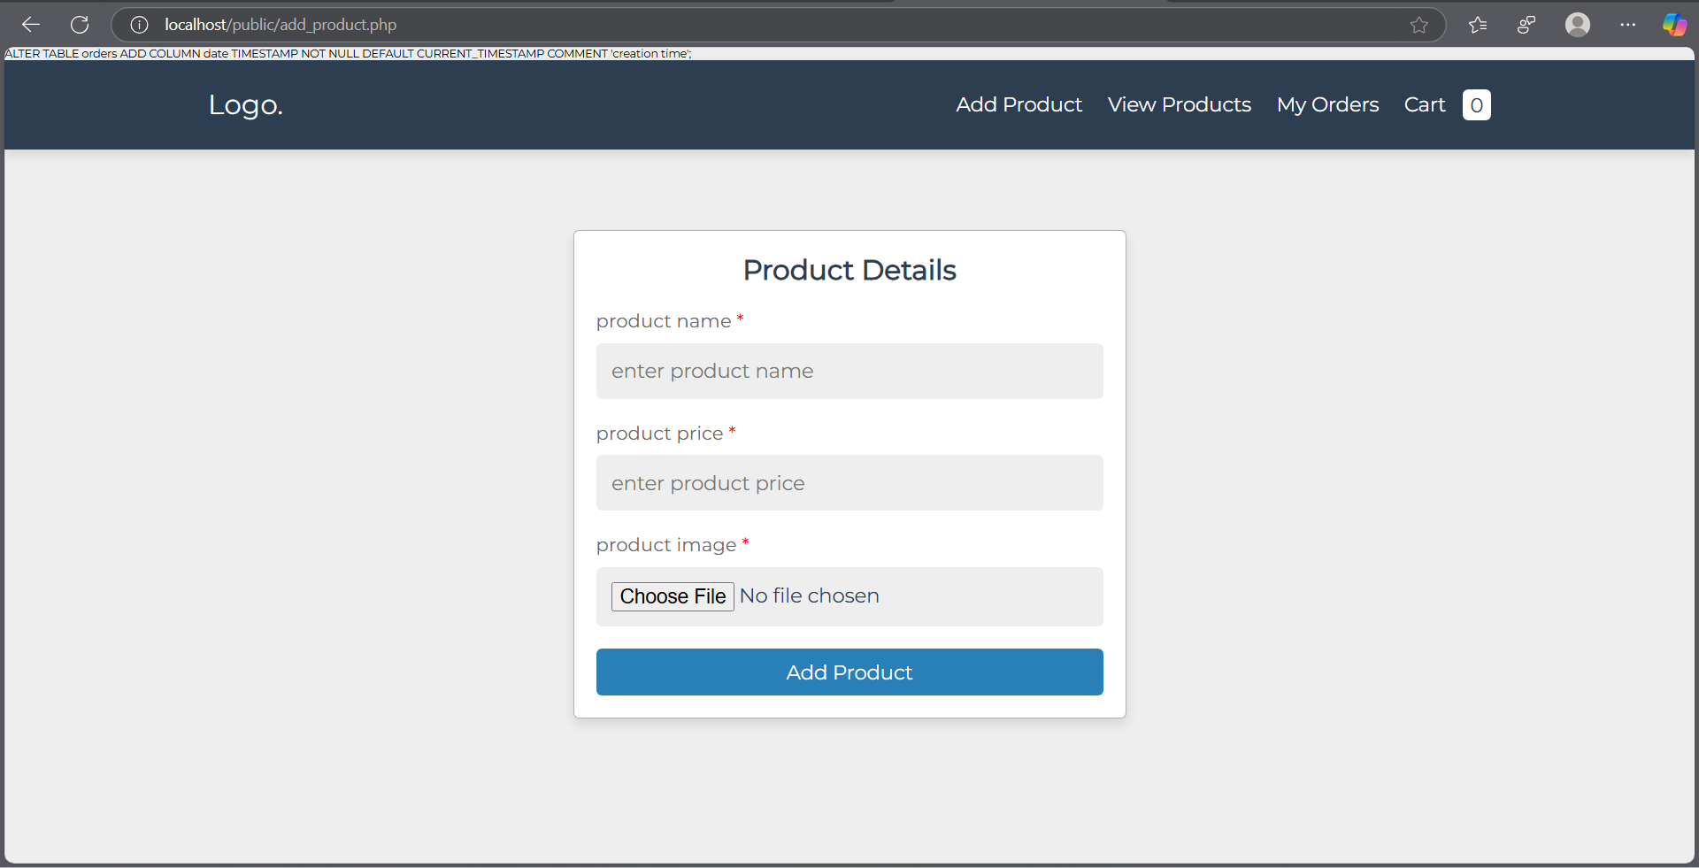

Slide 10
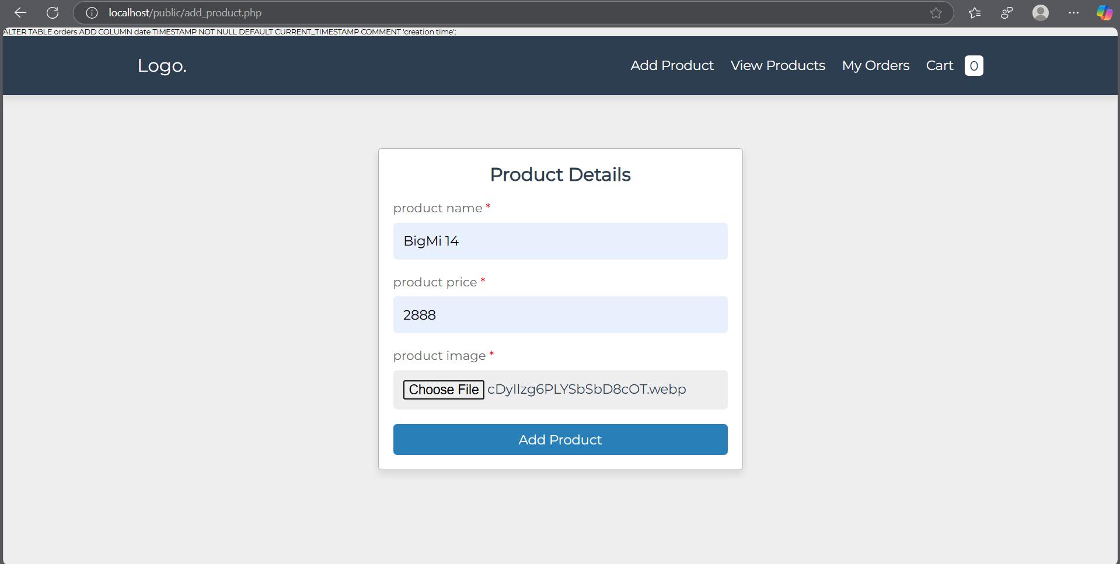

Slide 11
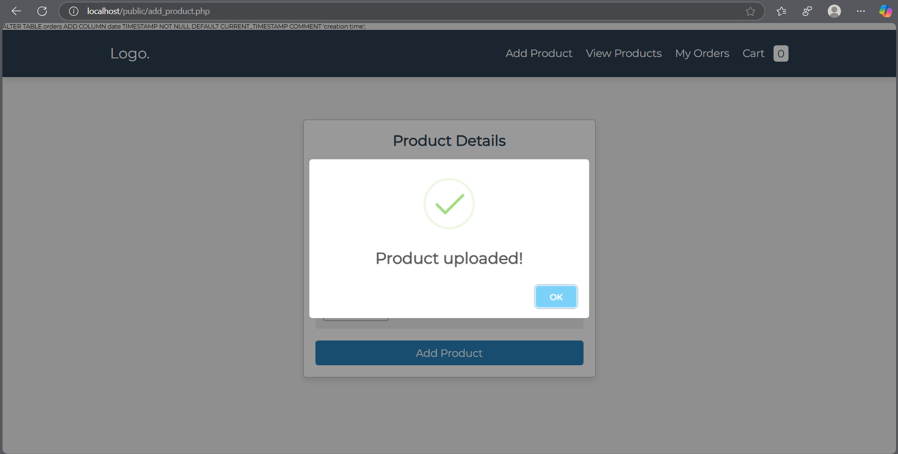

Slide 12
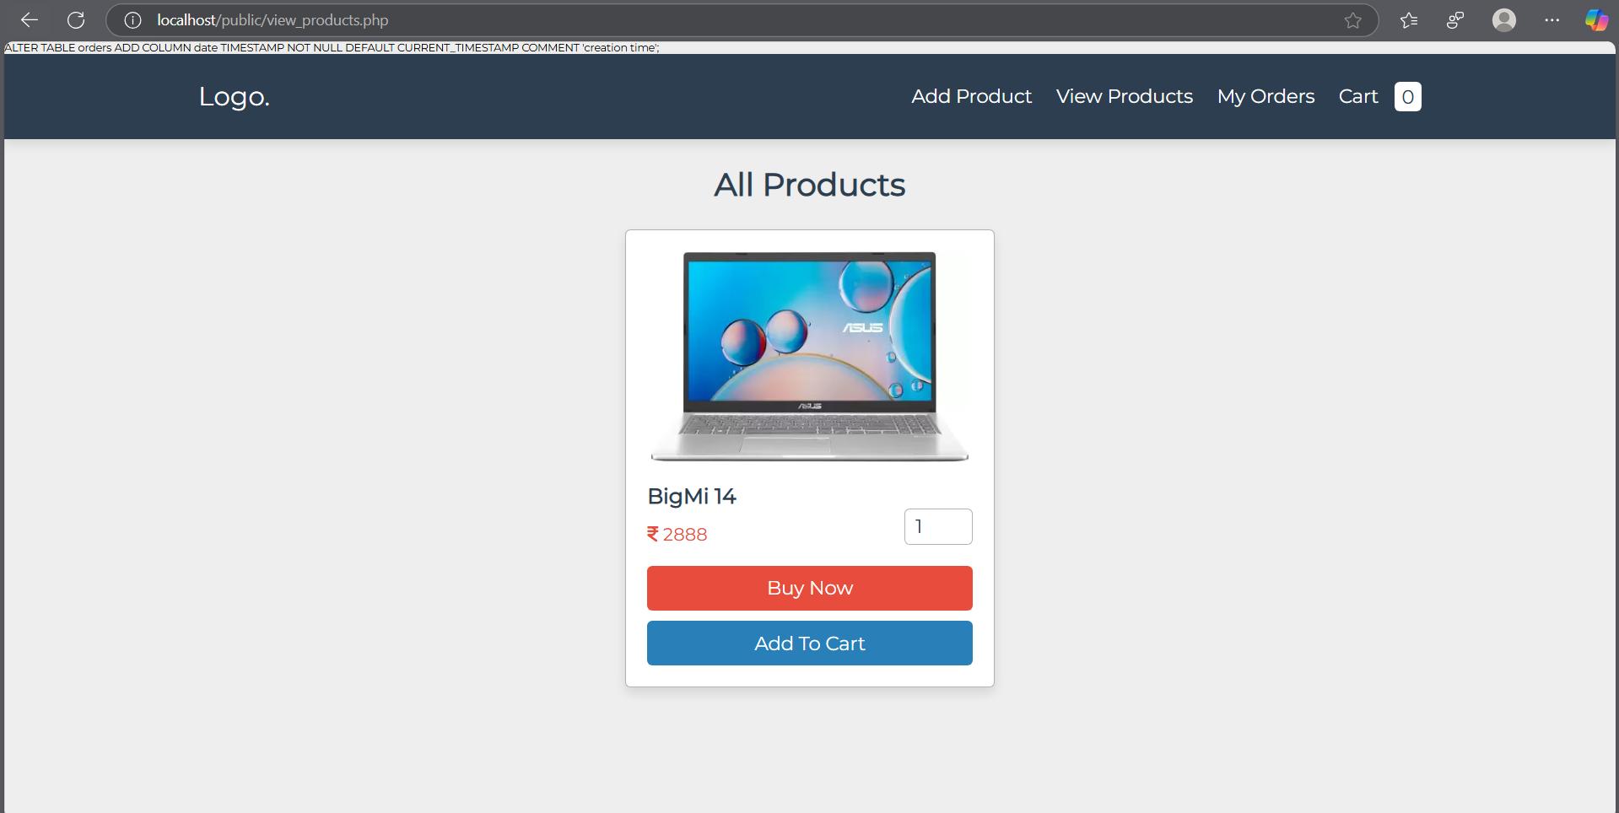

Slide 13
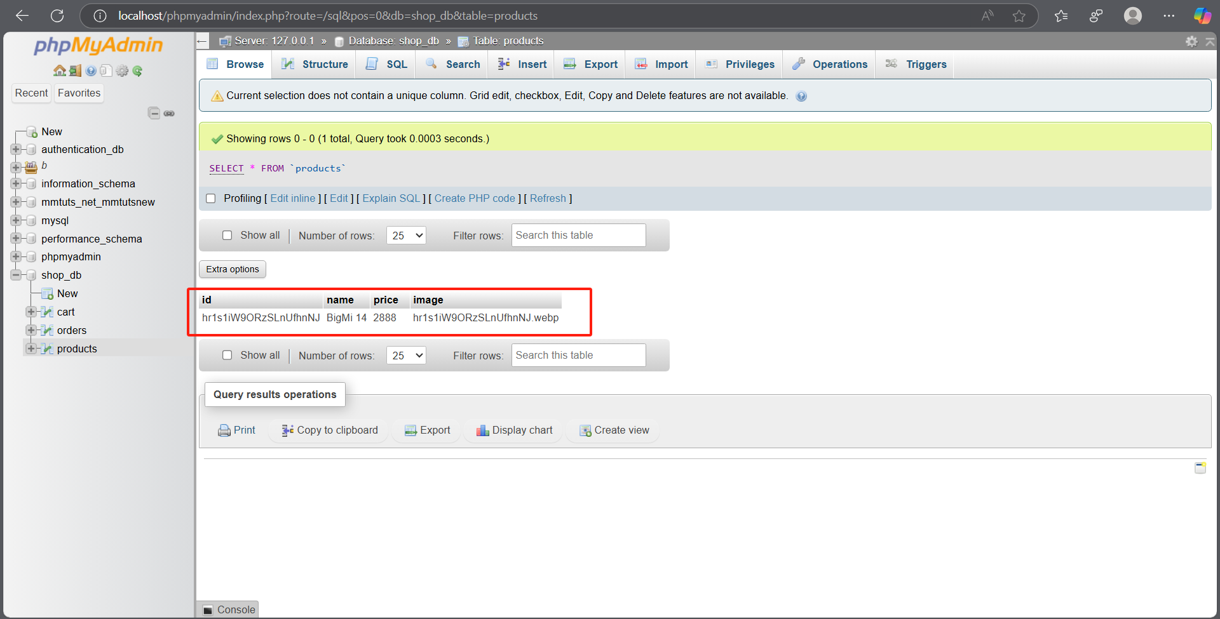

Slide 14
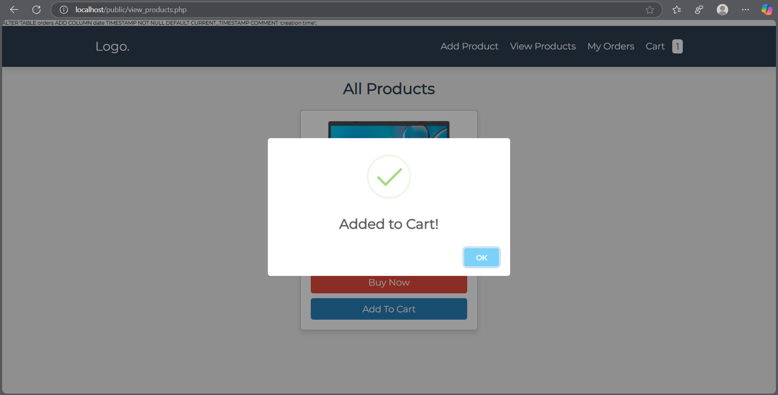

Slide 15
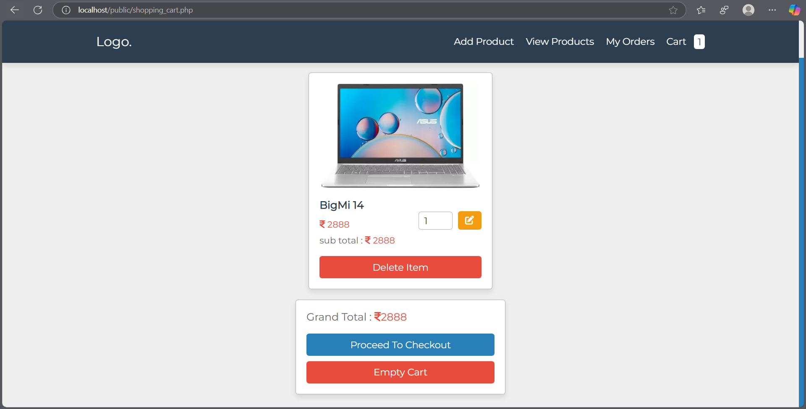

Slide 16
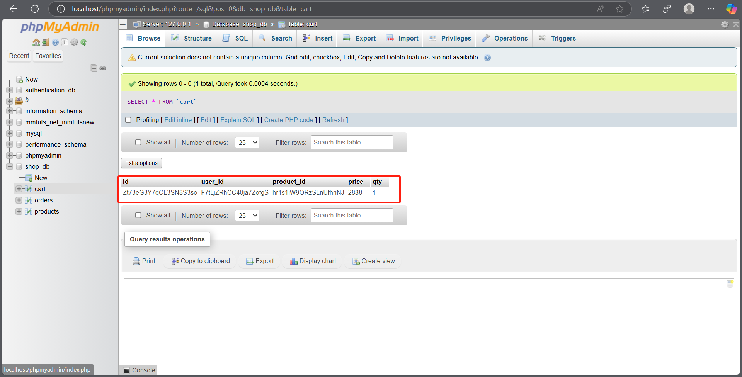

Slide 17
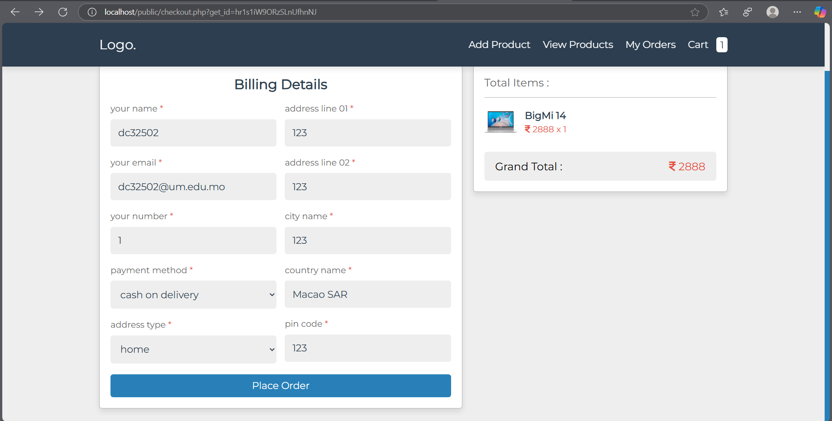

Slide 18
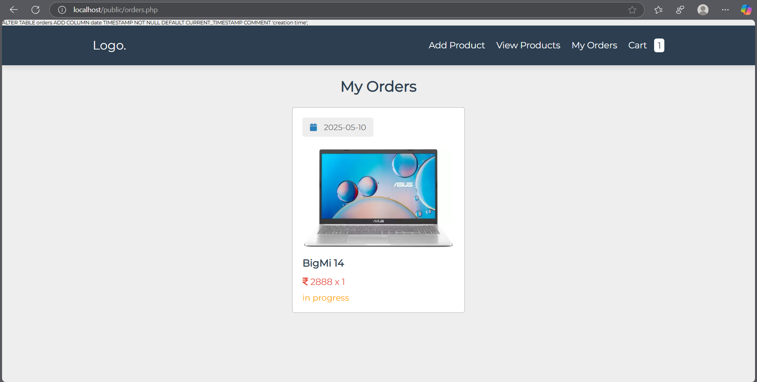

Slide 19
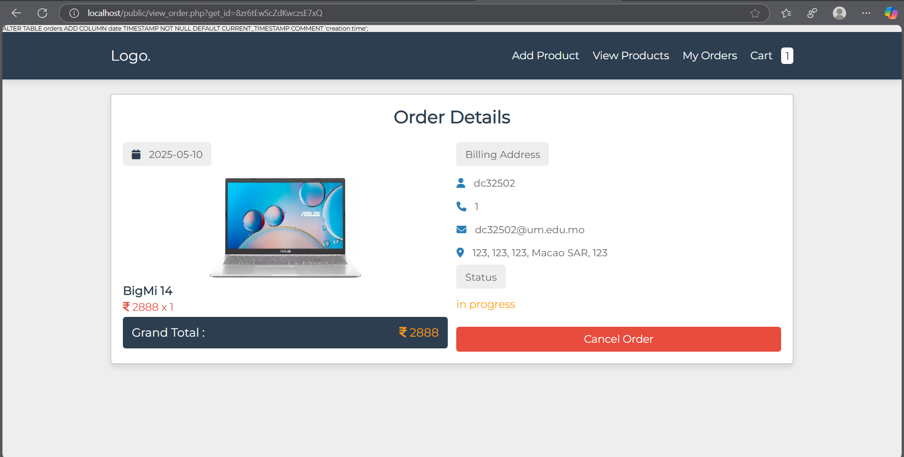

Slide 20
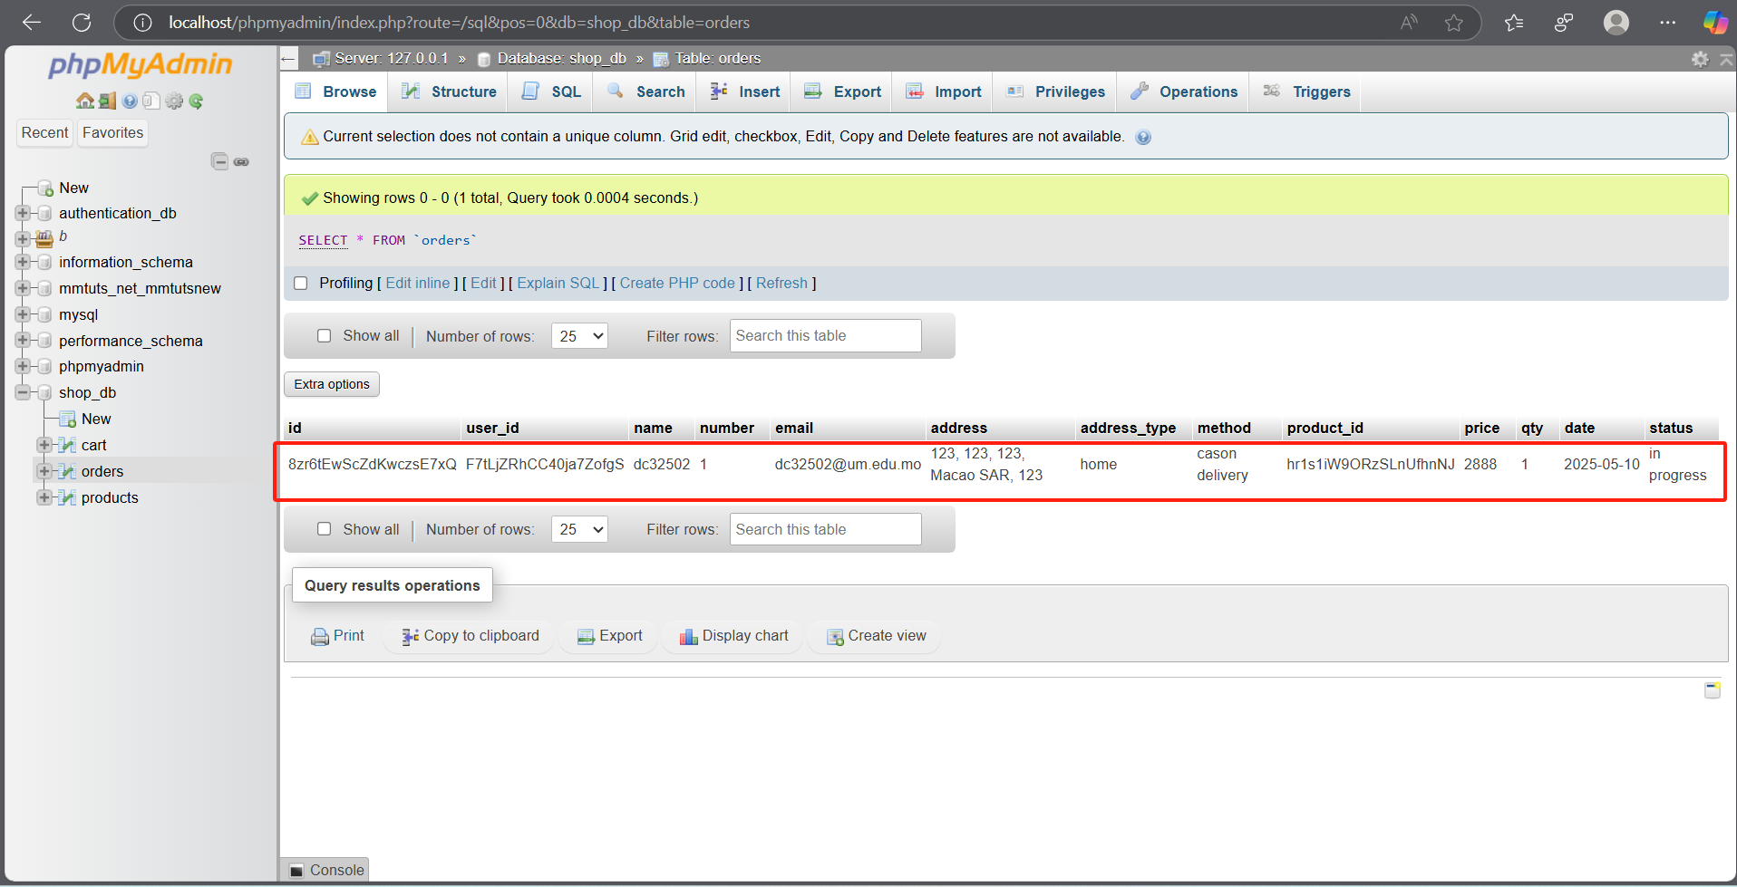

Slide 21
Part B: Authentication Features
Objective: Implemented fundamental user authentication mechanisms.
Scope: Developed five distinct operations related to registration and login.
Method: Followed a tutorial using XAMPP (PHP, MySQL) for backend logic.
Notes:
Moving on from the e-commerce platform, I also worked on a separate project focused on implementing fundamental user authentication features. This involved creating five distinct operations related to user registration and login, following a tutorial designed to solidify understanding in this critical area of web development.

Slide 22
Part B: Authentication Features
Implemented Core Operations (PHP & MySQL):
User Registration: New account creation (data stored in MySQL via PHP).
User Login: Credential validation against MySQL database (PHP).
User Logout: Securely end PHP session.
Profile Viewing/Updating: Basic user info management (MySQL & PHP).
Key Highlight: 5. Password Reset Functionality
Notes:
This project covered five core authentication operations. These included: **1. User Registration**, where new users can create an account by providing their details, which are then securely stored in the MySQL database via PHP; **2. User Login**, allowing existing users to access their accounts by validating their credentials against the database; **3. User Logout**, enabling users to securely end their PHP session; **4. Profile Viewing/Updating** (or another simple operation as per the tutorial), allowing logged-in users to see or modify some basic information stored in MySQL; and the fifth, which I'll focus on, is the **Password Reset functionality**.

Slide 23
Part B
Website 5

Slide 24
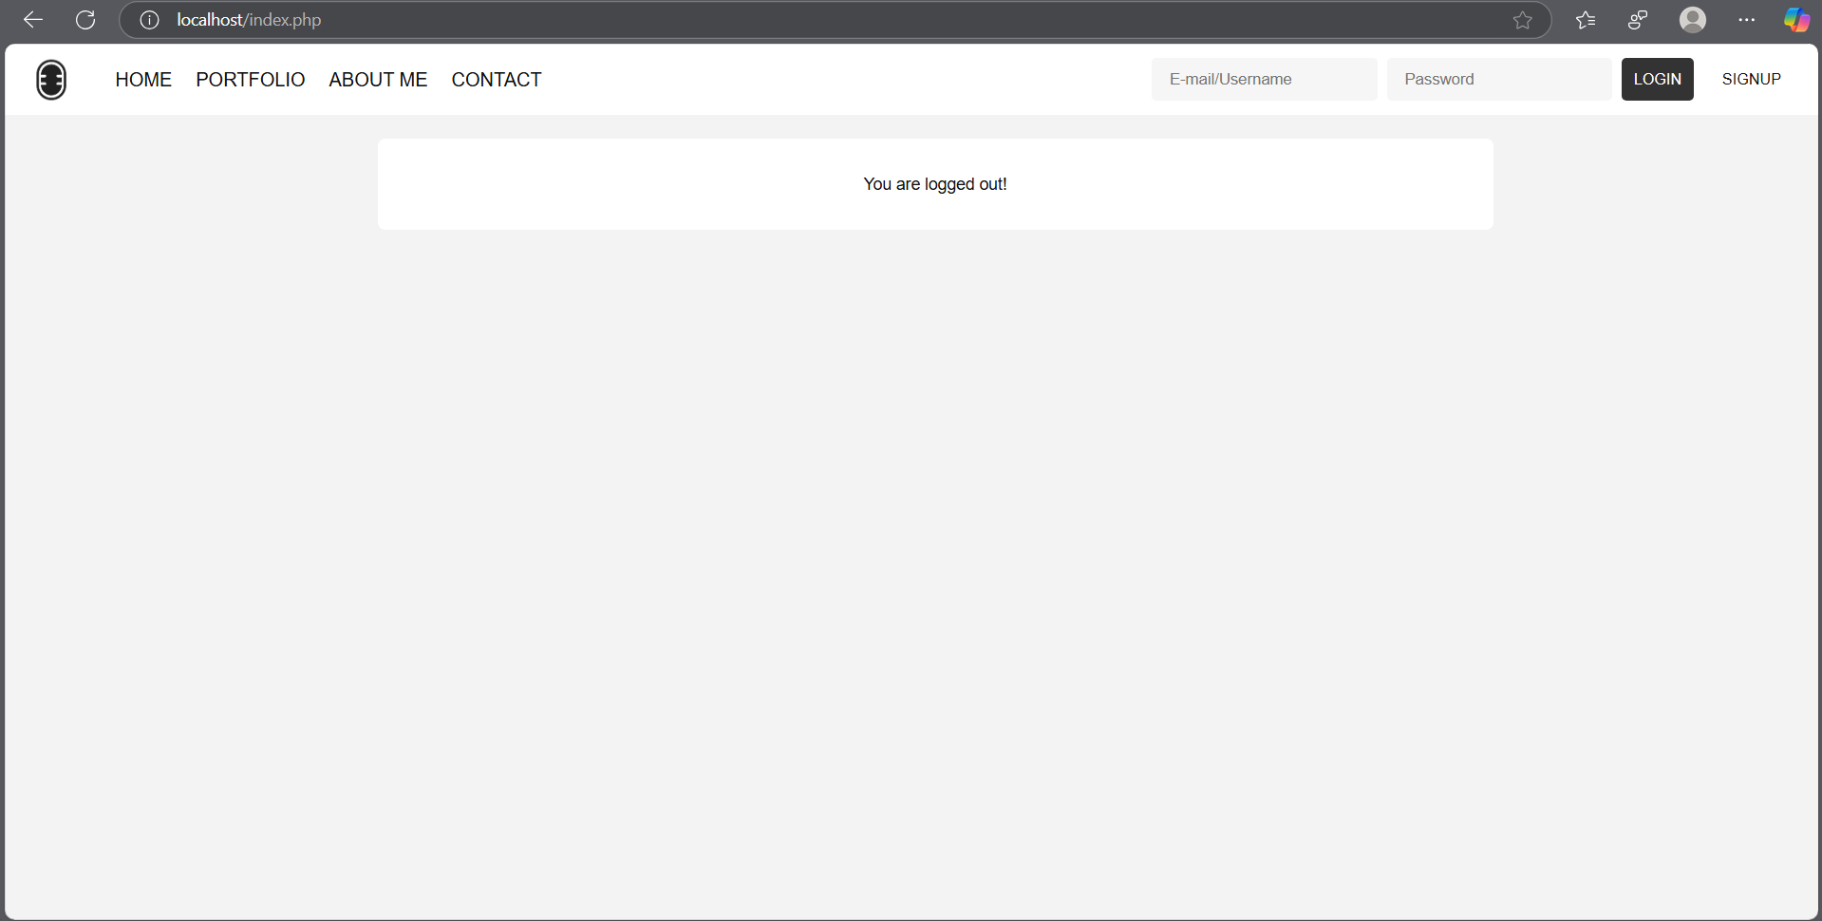

Slide 25
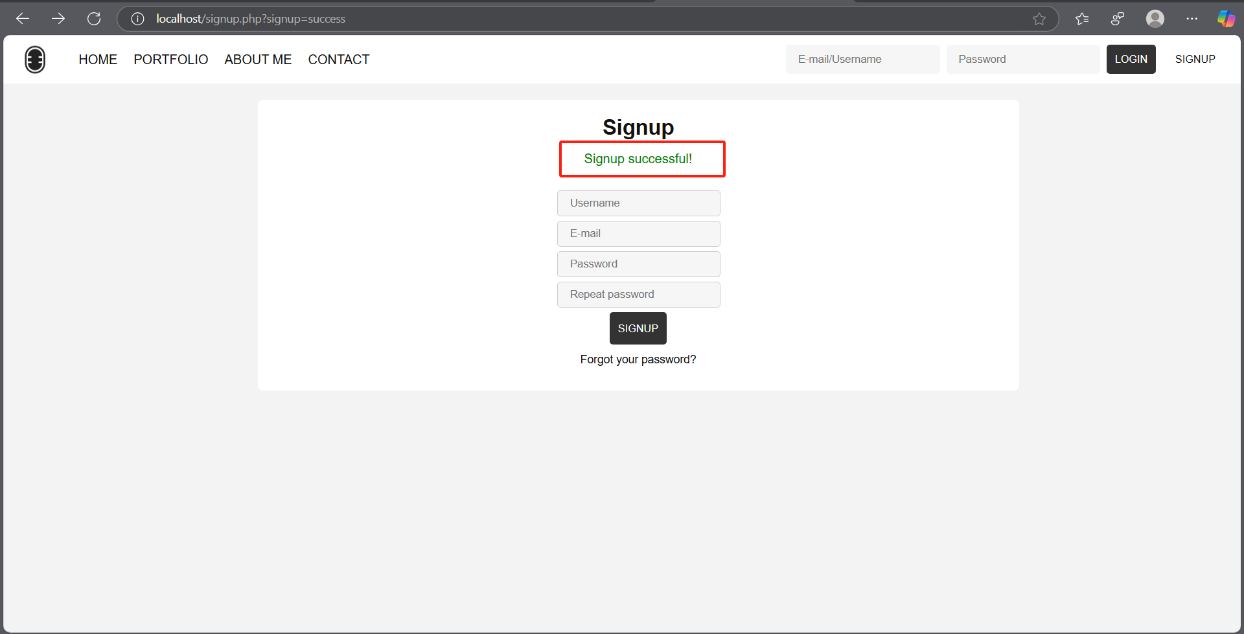

Slide 26
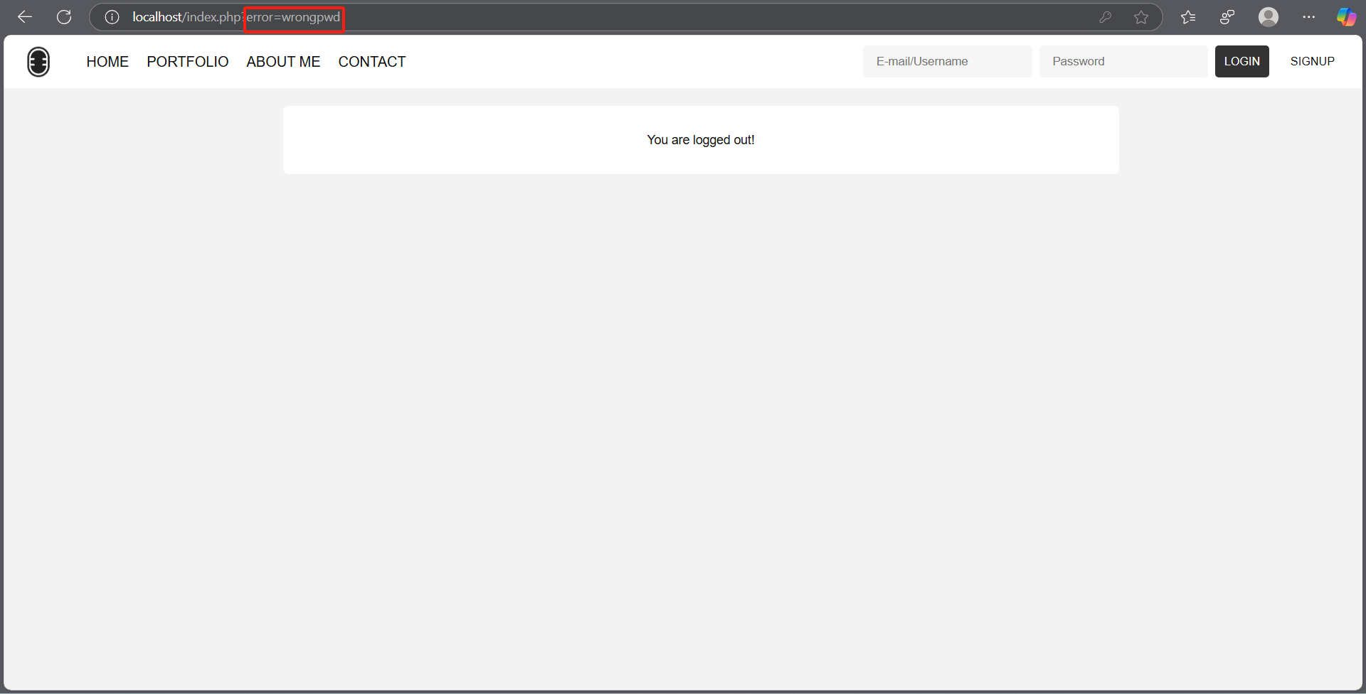

Slide 27
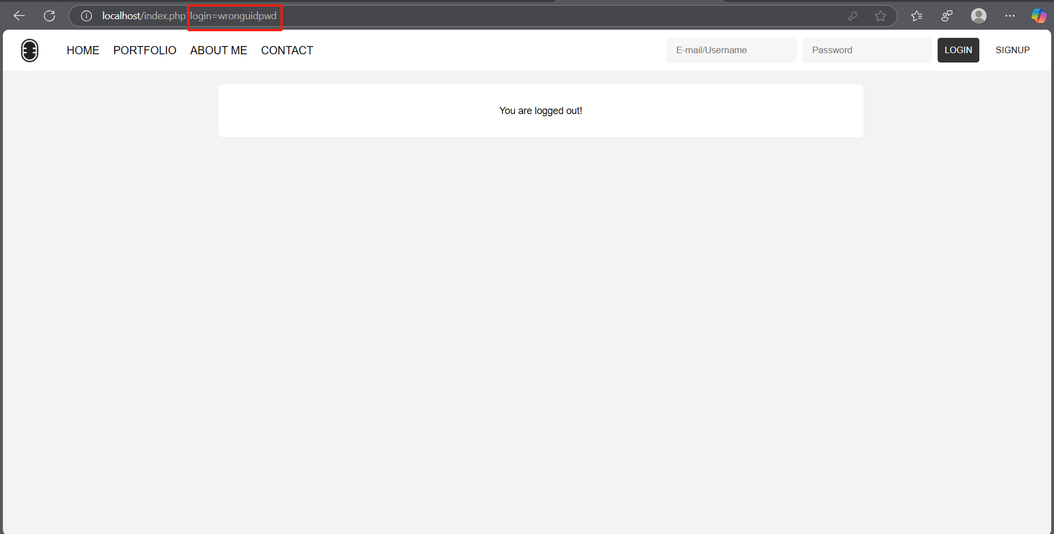

Slide 28
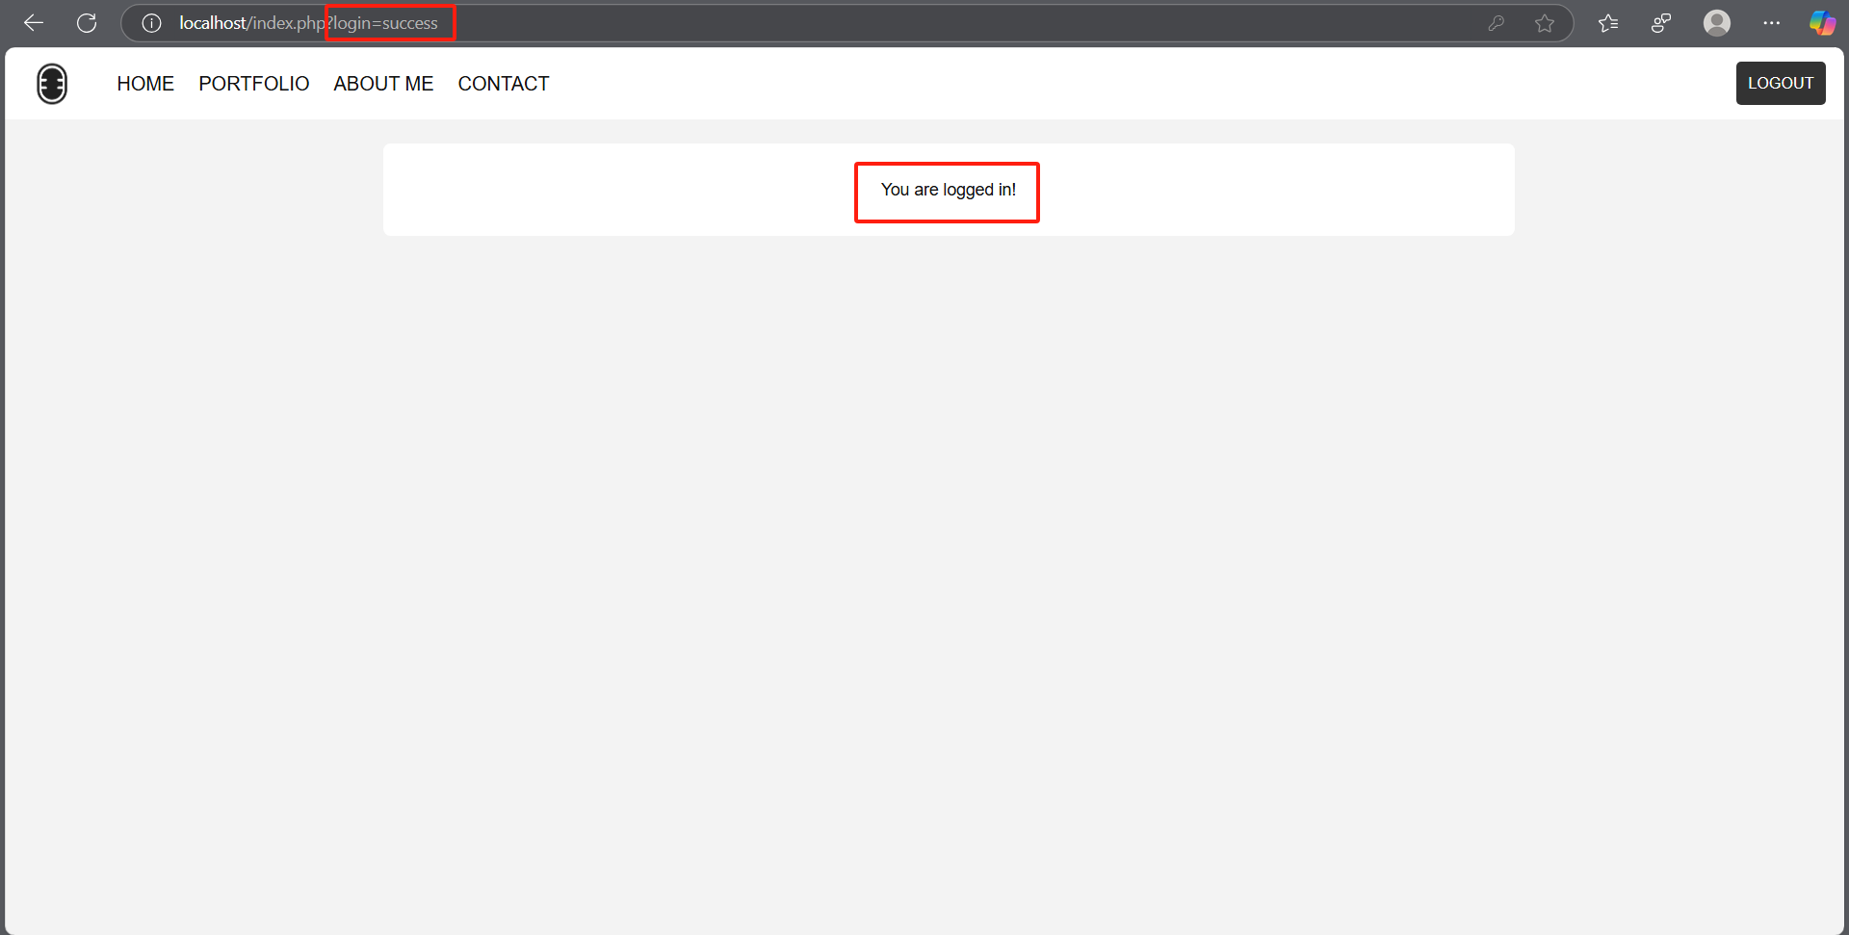

Slide 29
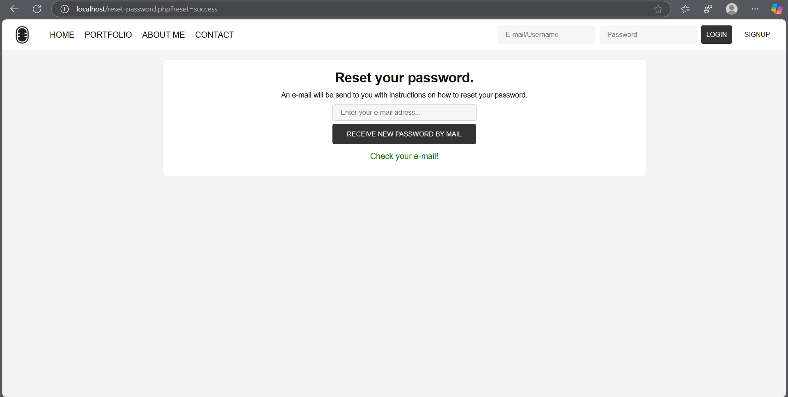

Slide 30
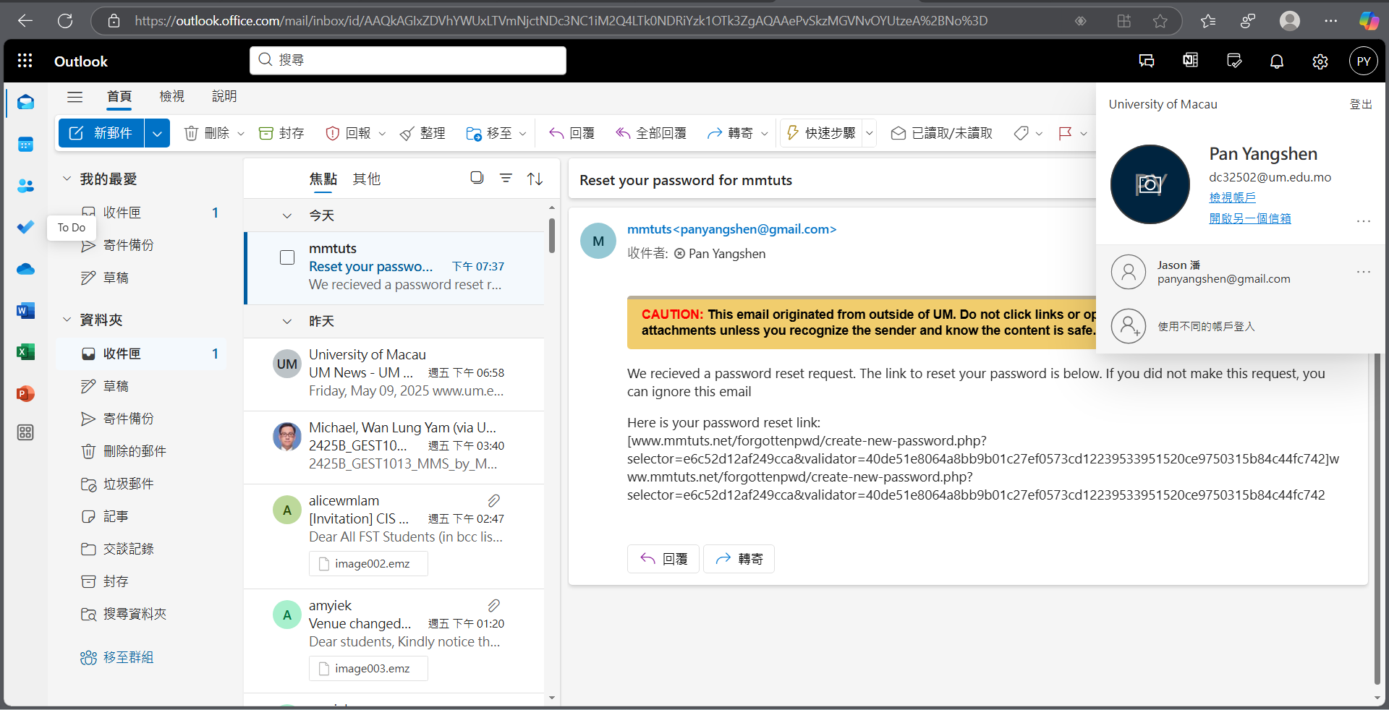

Slide 31
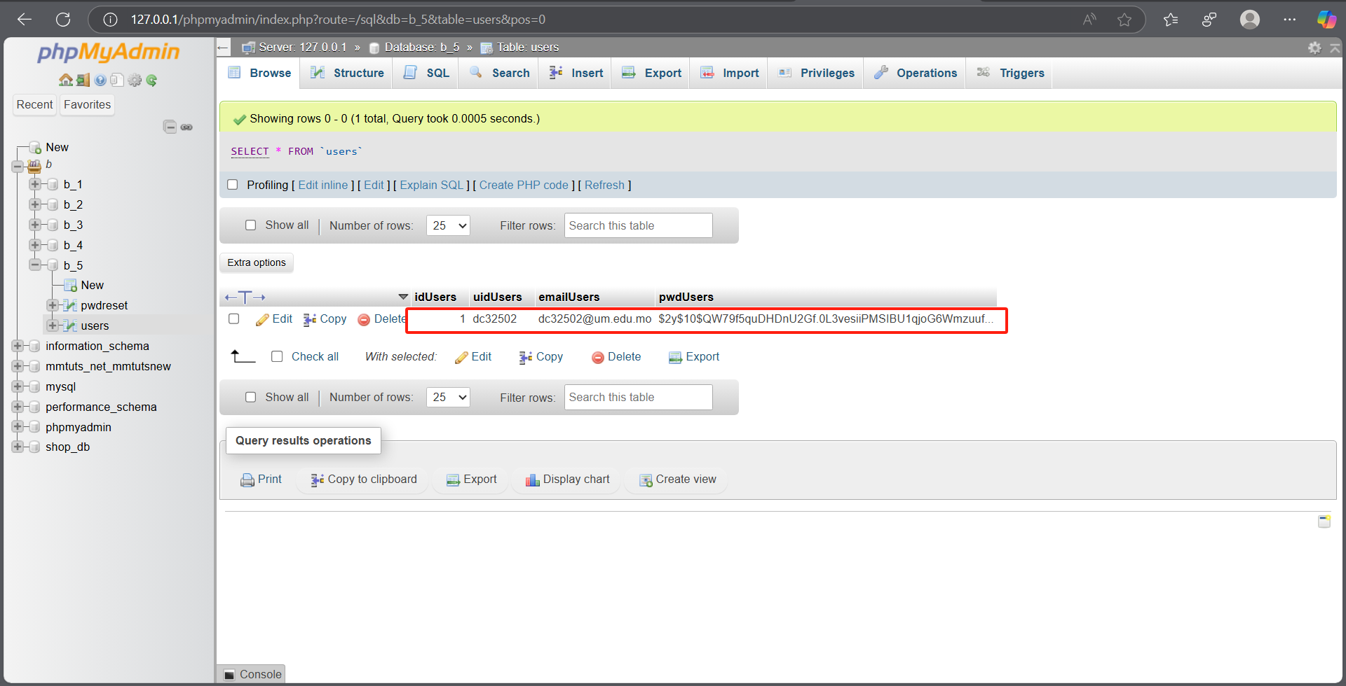

Slide 32
Recap of Achievements (XAMPP, PHP, MySQL):
Developed a shopping website (product management, cart, orders).
Implemented essential authentication features (registration, login, secure password reset).
Notes:
So, to quickly recap, we've covered the development of a shopping website built with PHP and MySQL, featuring product management, cart functionality, and order processing. We also looked at the implementation of essential authentication mechanisms using the same stack, including user registration, login, and a secure password reset system.

Slide 33
Key Learnings:
Valuable insights into full-stack web development with XAMPP (PHP, MySQL).
Understanding of security best practices in web applications.
Notes:
These projects have been fantastic learning experiences, particularly in understanding full-stack development with XAMPP, PHP, and MySQL, and applying security best practices. That’s all! Thank you. Now I will show you all websites.

Slide 34
Thank you!

Slide 35
Part B
Website 1

Slide 36
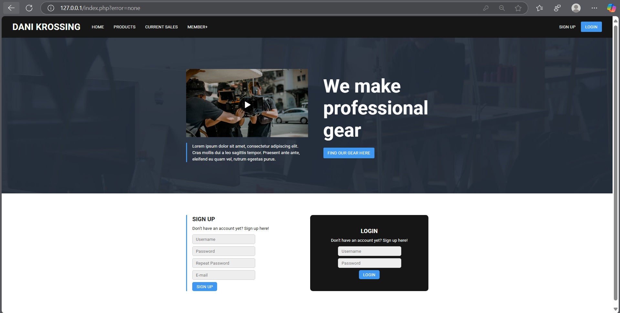

Slide 37
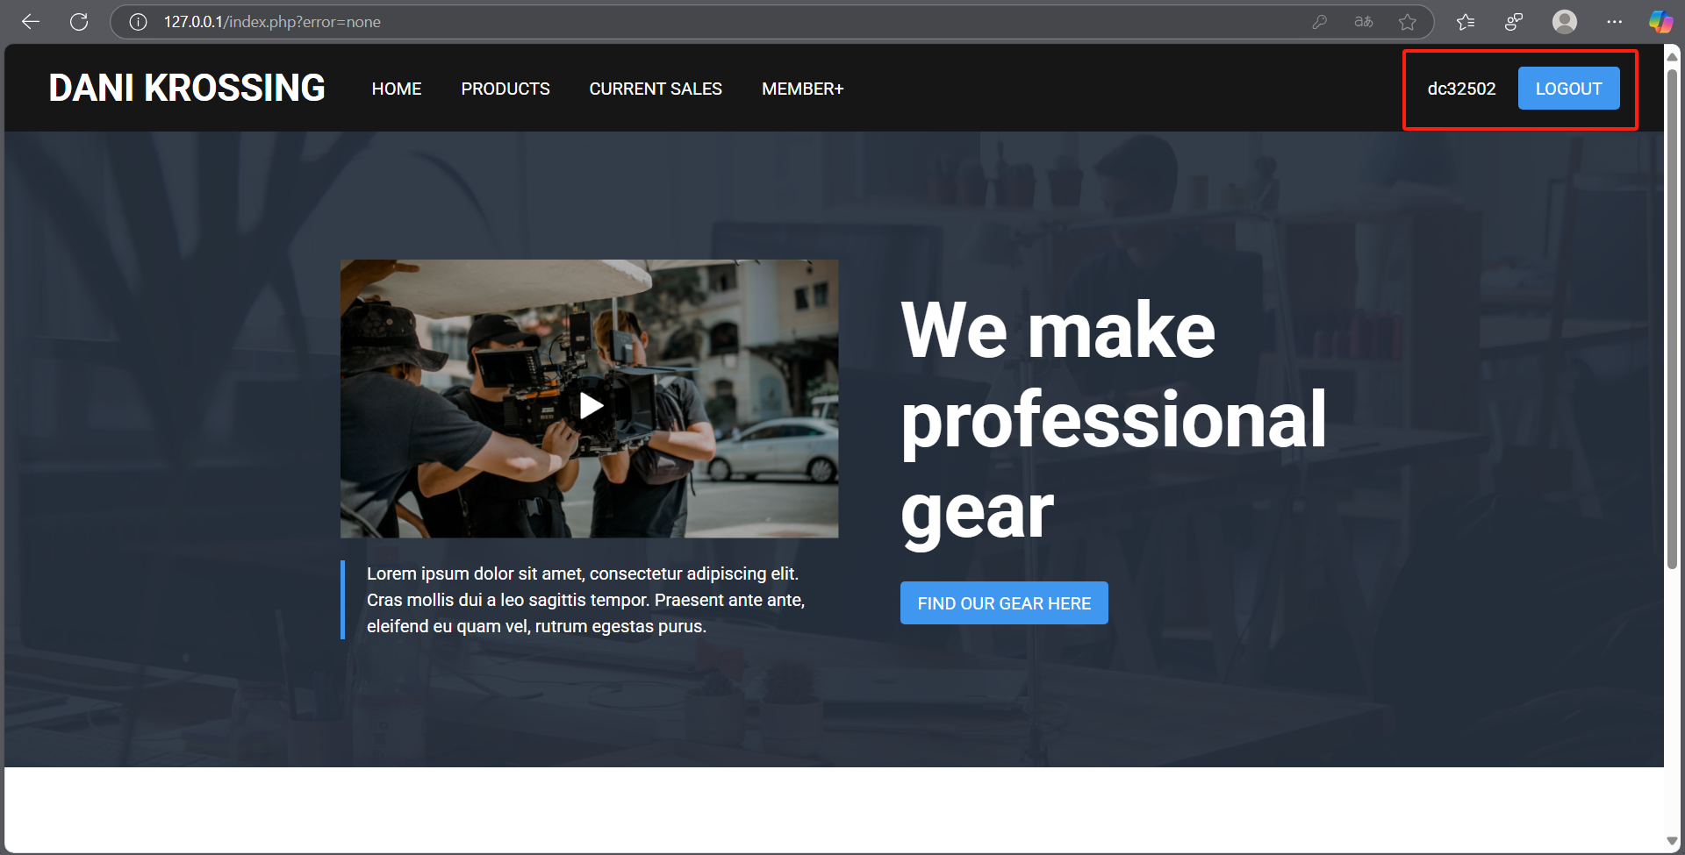

Slide 38
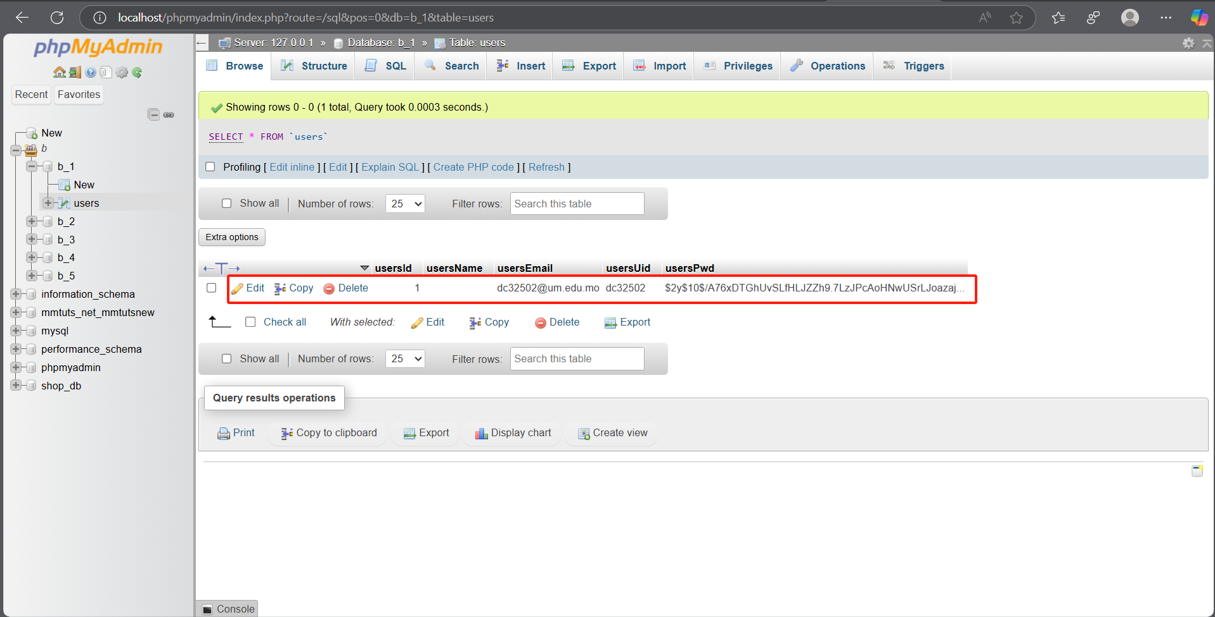

Slide 39
Part B
Website 2

Slide 40
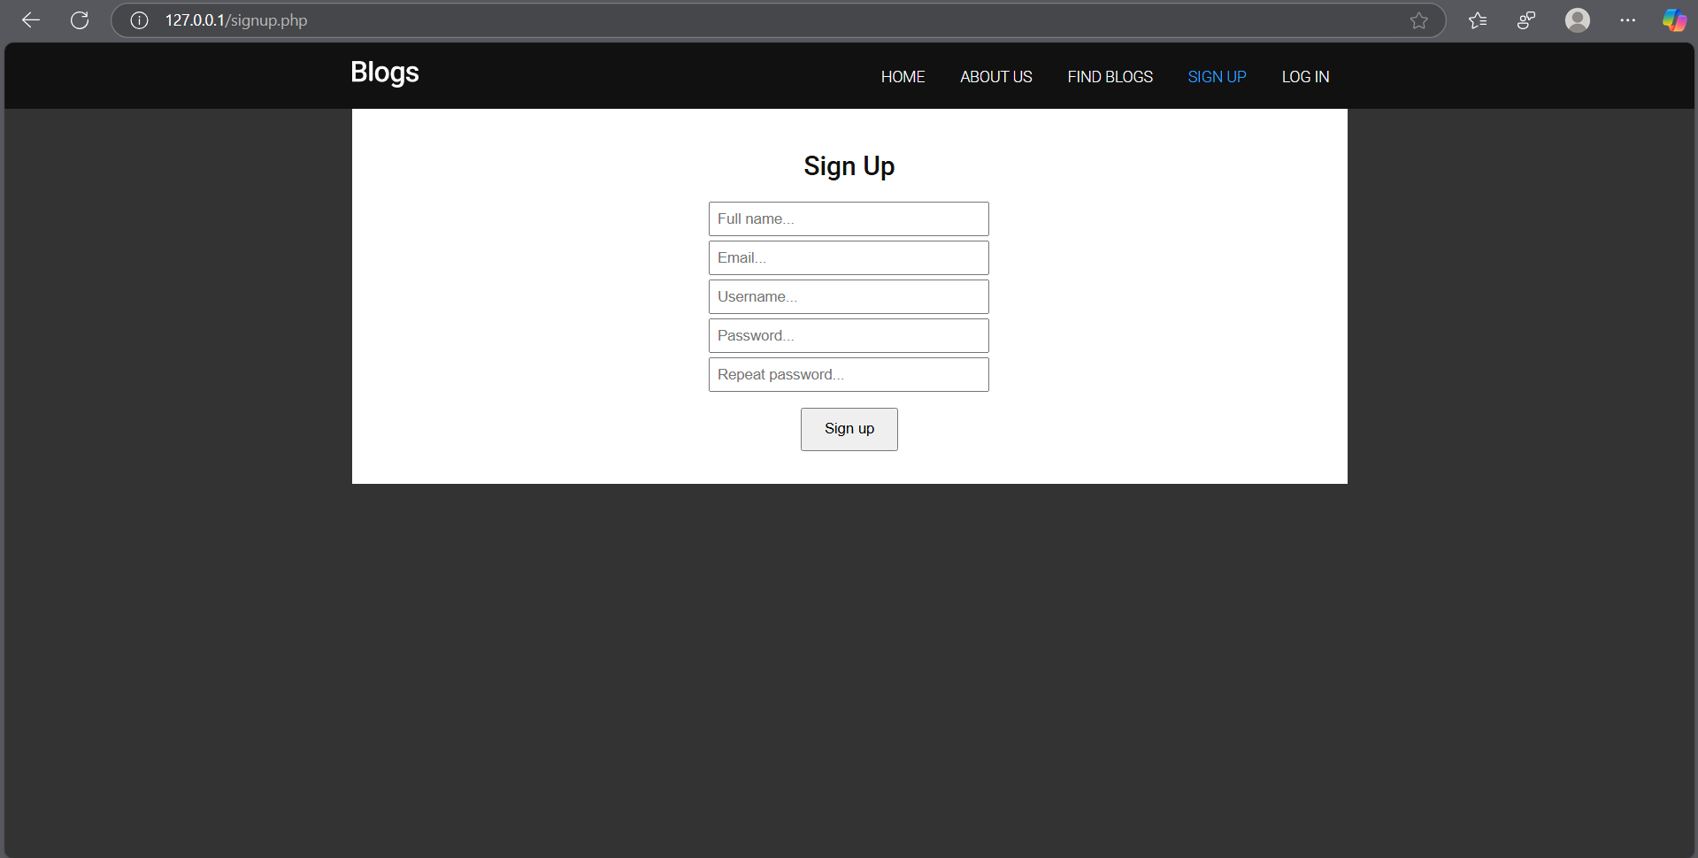

Slide 41
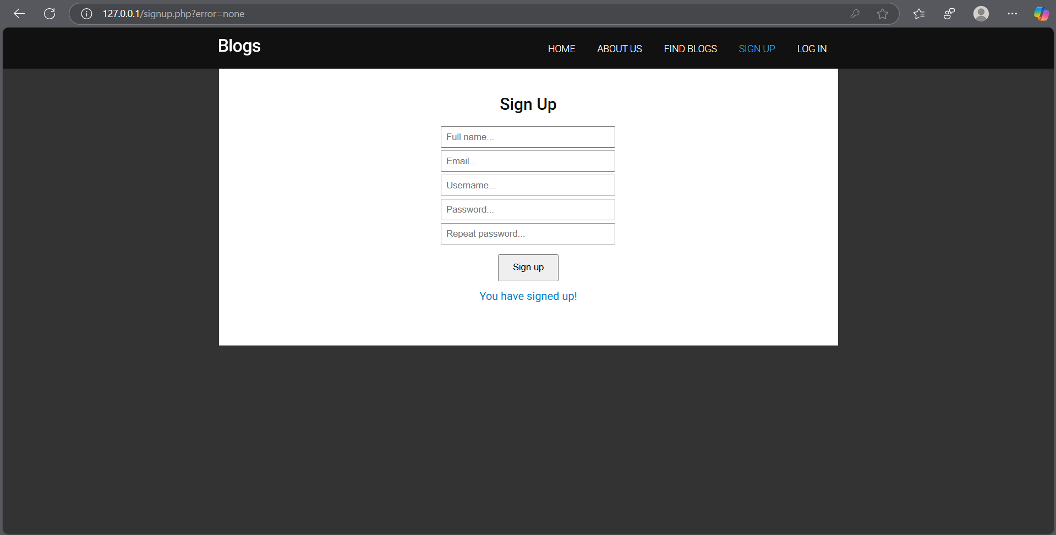

Slide 42
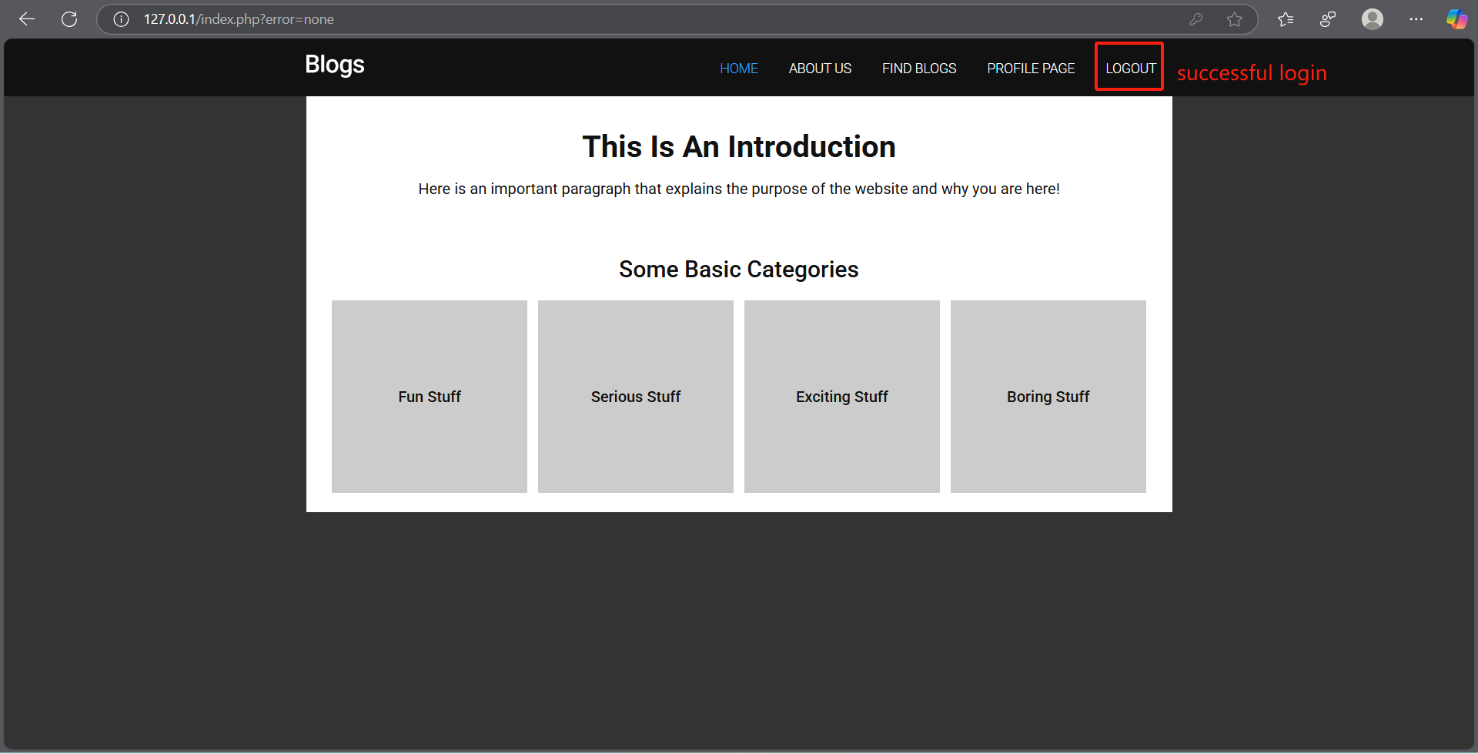

Slide 43
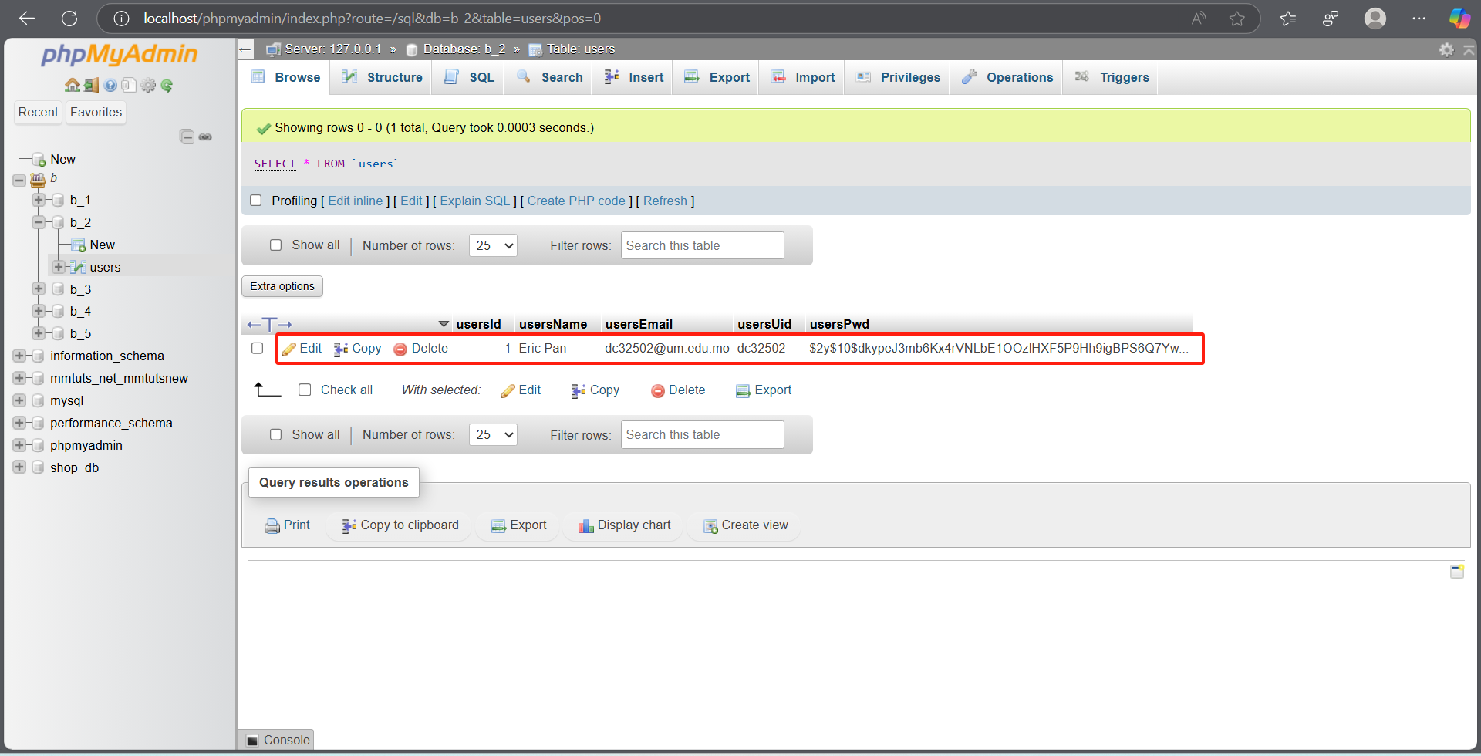

Slide 44
Part B
Website 3

Slide 45
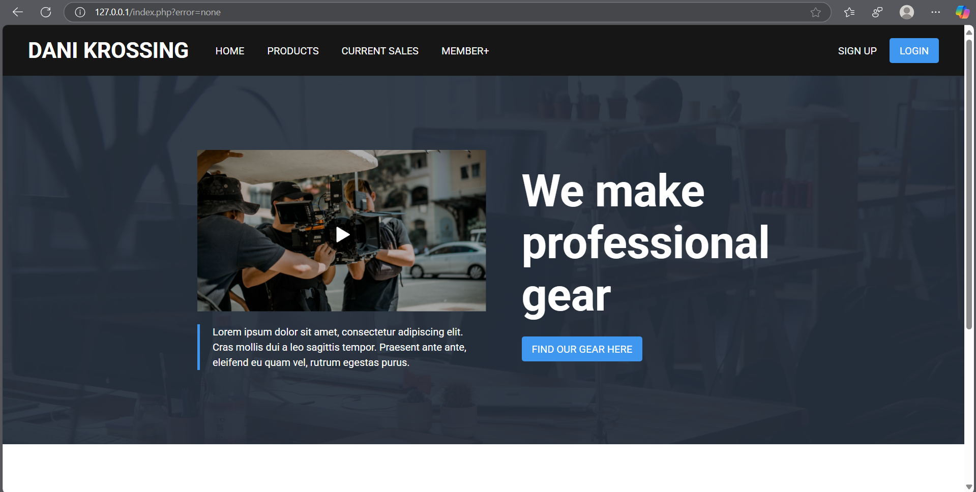

Slide 46
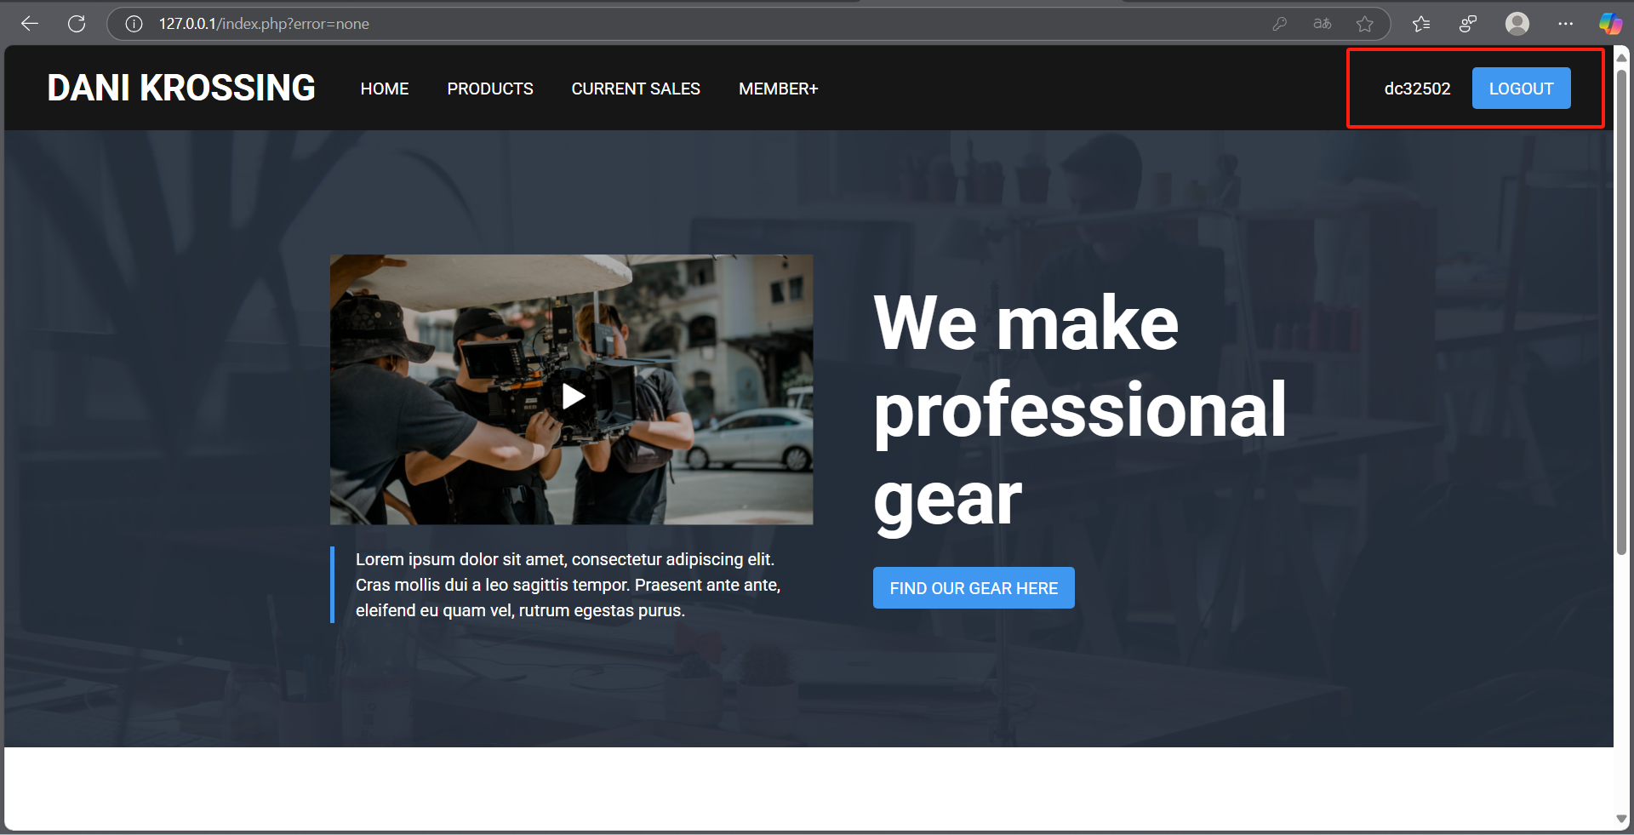

Slide 47
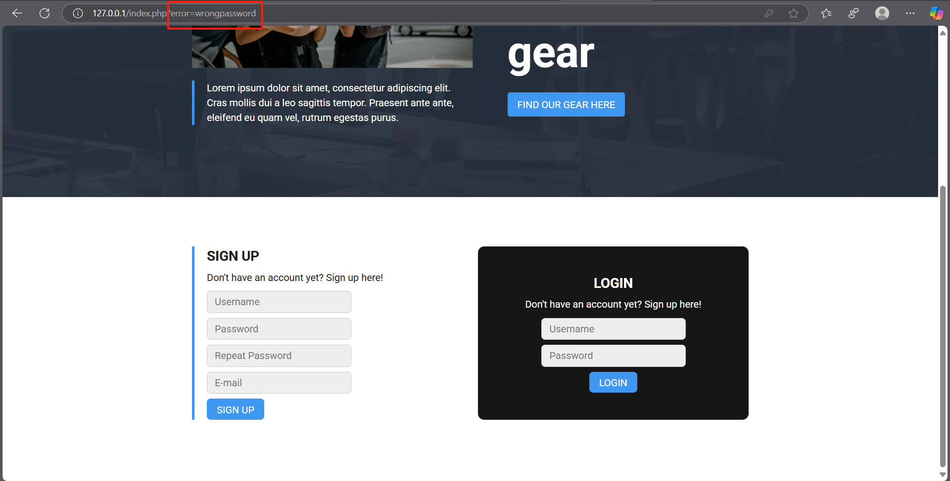

Slide 48
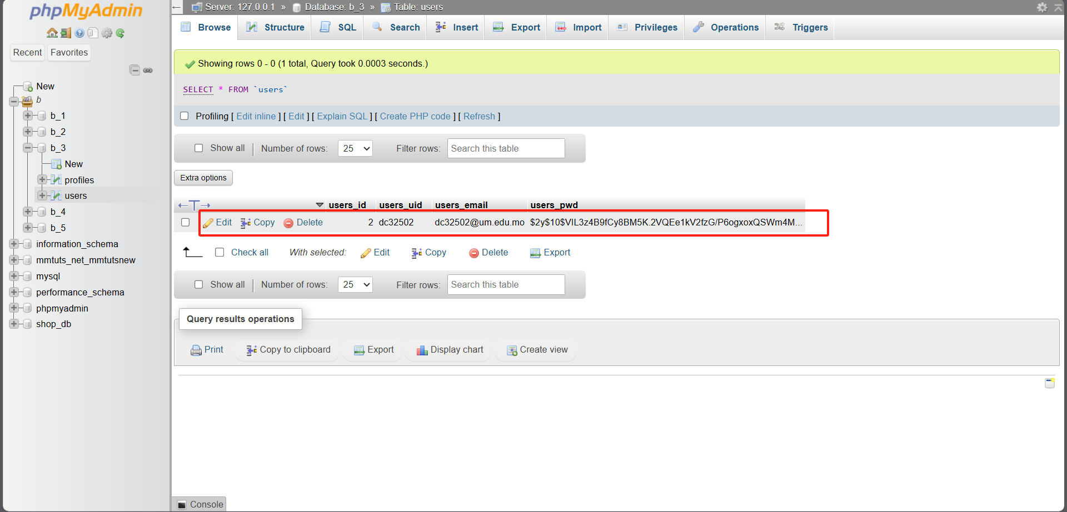

Slide 49
Part B
Website 4

Slide 50
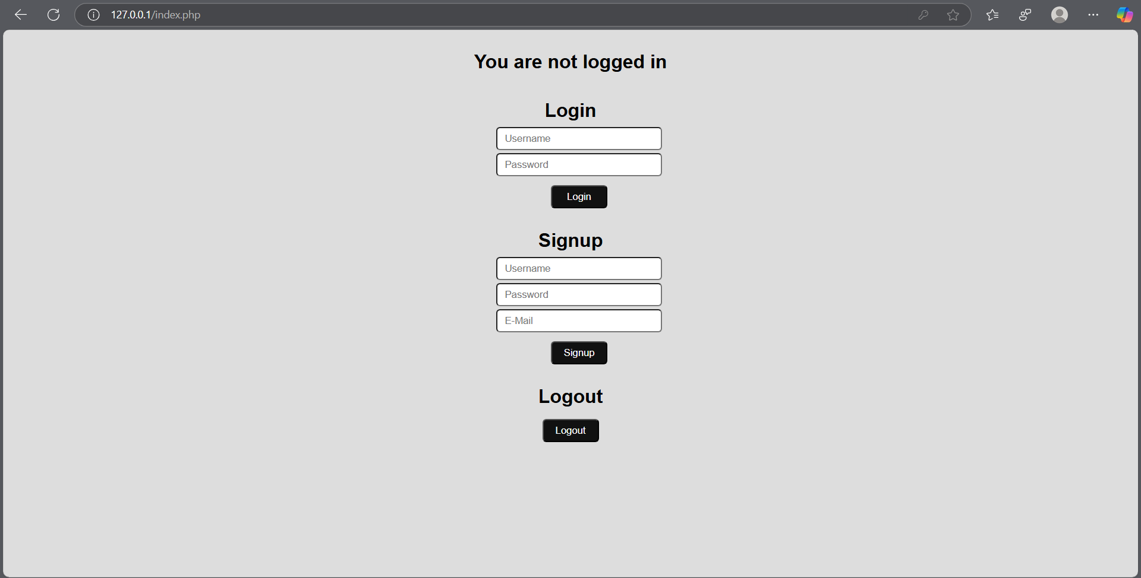

Slide 51
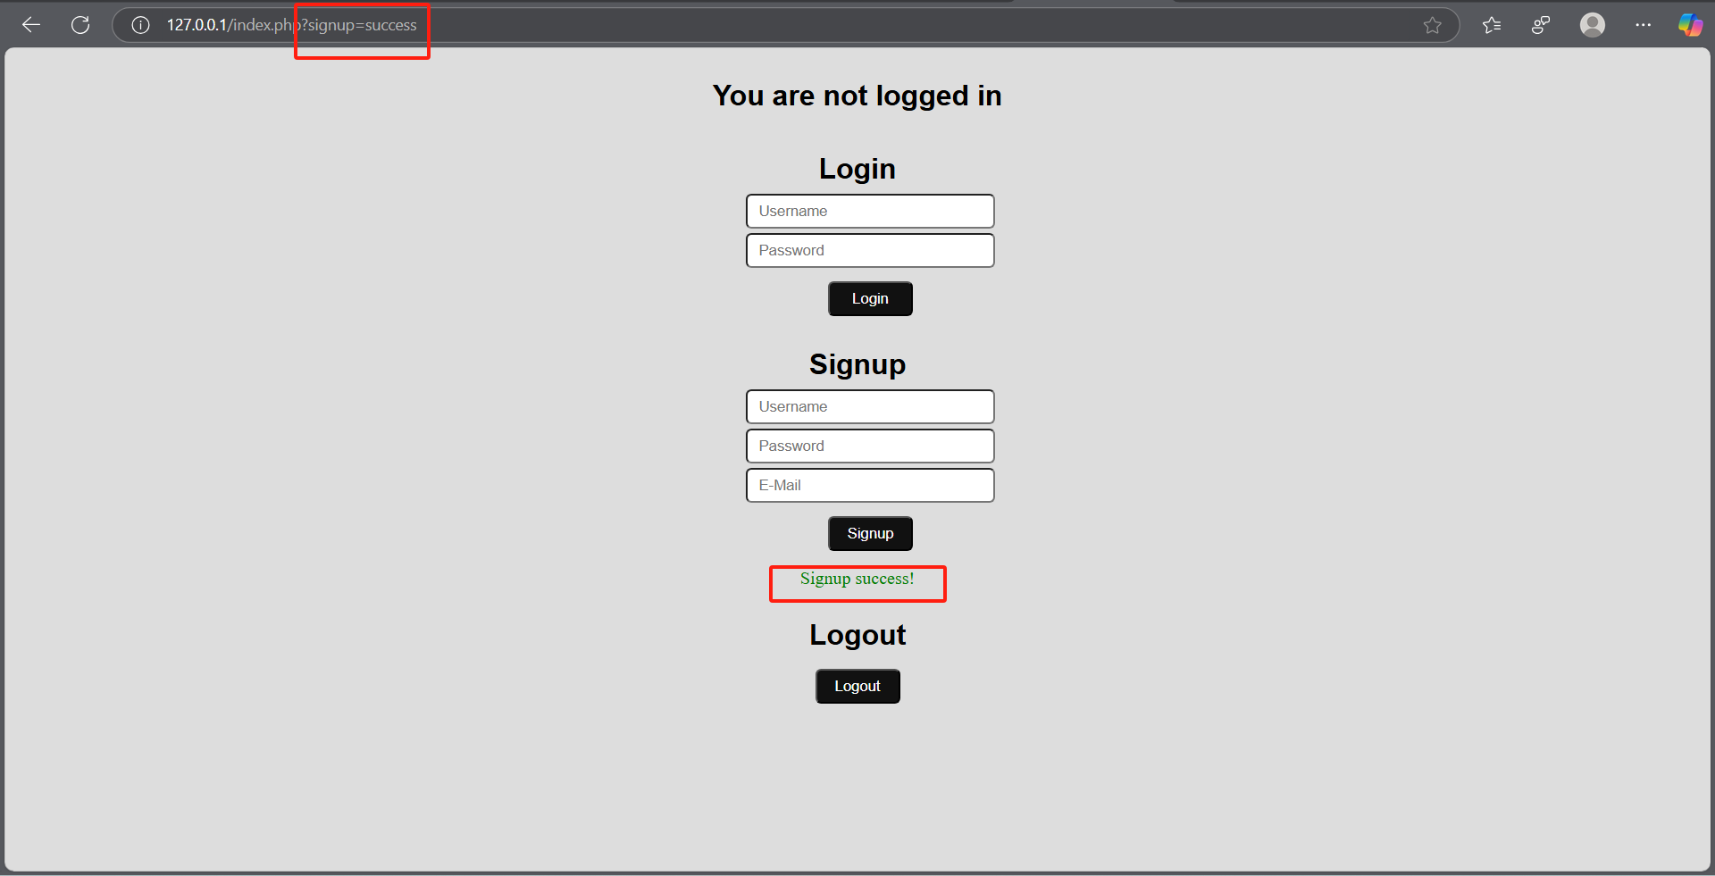

Slide 52
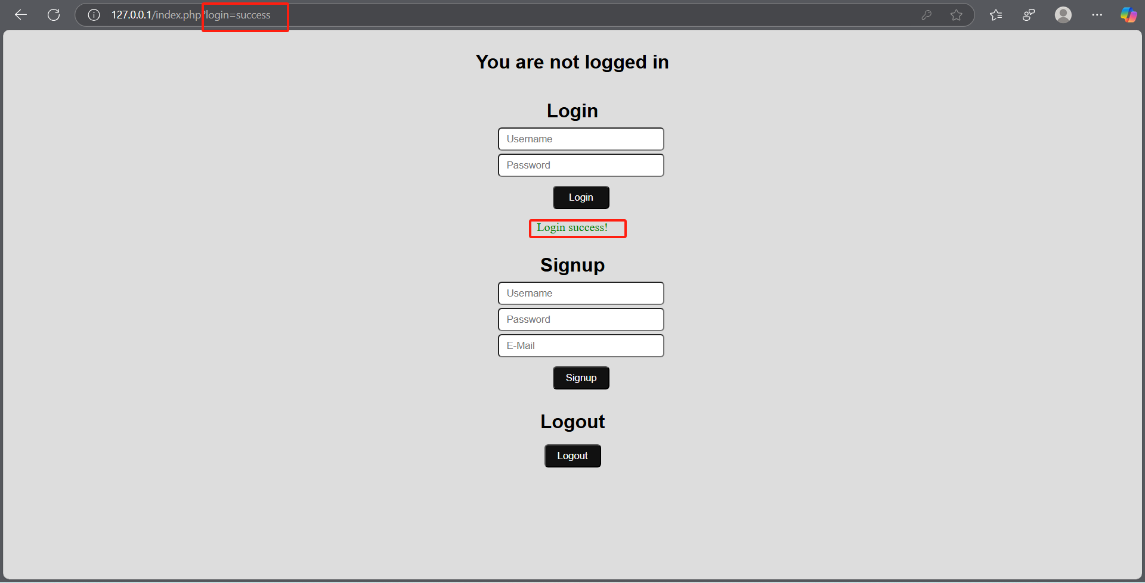

Slide 53
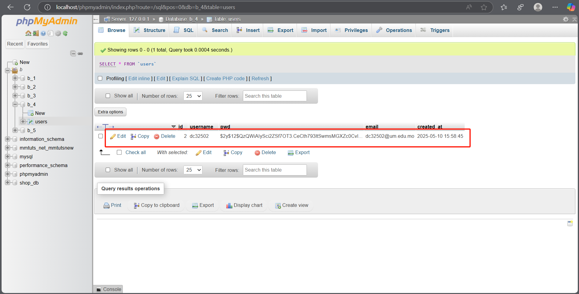

Slide 54
Part B
Website 5

